Slide 1

Introduction to Robotics ME 639: Industrial Project Presentation 2
Project Title: Underwater Manipulator’s Control System
Team Name: Team Pluto
Team Members: Dhvani Shah, Dev Patel, Harsh Shrivastava
Instructor: Prof. Harish PM
Teaching Assistant: Suraj Borate

Slide 2
Problem Statement:
“ Design a control system for a 2 Dof manipulator of an underwater ROV”
Industry name: Planys Technologies
Objectives:
Find the shortest path and duration between two readings
Appropriate value of acceleration and velocity
Account for underwater dynamics in control system
Suggestions of suitable actuators
1

Slide 3
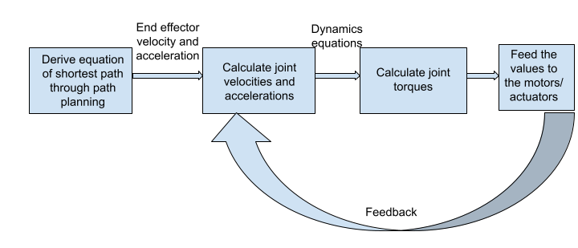
Rationale / Approach / Ideas:
What we had presented earlier

Slide 4
Rationale / Approach / Ideas:
🗹 Deriving the forward and inverse kinematic equation for the manipulator.
🗹 Plotting the workspace
🗹 Looking for the shortest path between two points
🮕 Understanding the underwater dynamics.
🮕 Designing a PID controller for independent joint control.
2

Slide 5
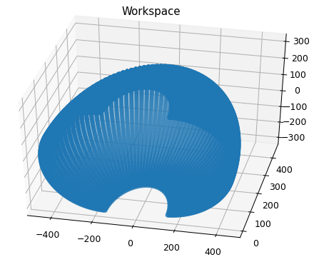
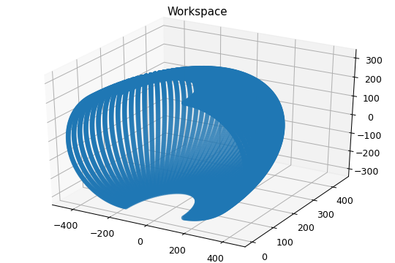
Key Results 1:
Robot Workspace:
3
Notes:
Angle limits: -90º to +90º
Length:

Slide 6
Insights / Interim Conclusions / Discussion:
As we can see from the workspace, it is impossible for robot to travel in straight line, as most points won’t lie in workspace.
We propose that instead of deriving the shortest path, we will try to reduce the work done by motor, by allowing minimum angular displacement to reach the desired location.
6

Slide 7

Key Results 2:
Inverse kinematics:
We have implemented the inverse kinematics code such that given the two coordinate points, we get the angular orientations of both the joints.
Example:
Input:
Output:
4

Slide 8
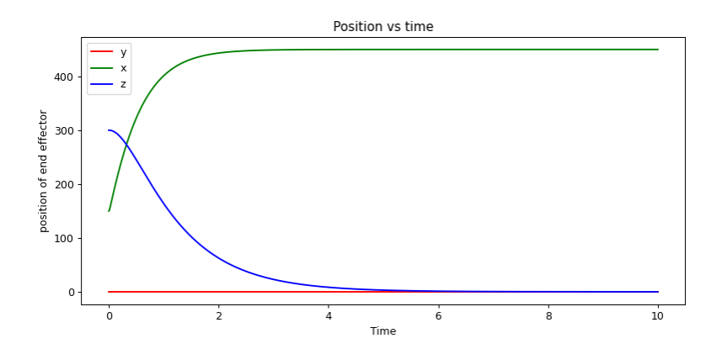
Key Results 3:
5
Notes:
End effector position w.r.t time
Qualitative Plot

Slide 9
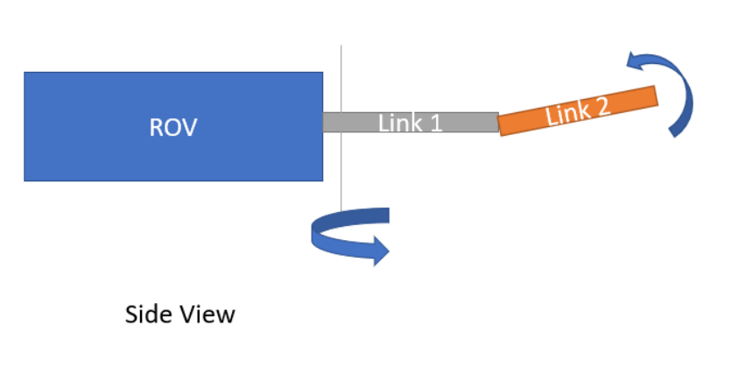
Appendix 1: Dimensions
Dimensions:
m1 = 1.5 kg, m2 = 1 kg, m_probe = 0.5 kg
l1 = 150 mm, l2 = 300 mm

Slide 10
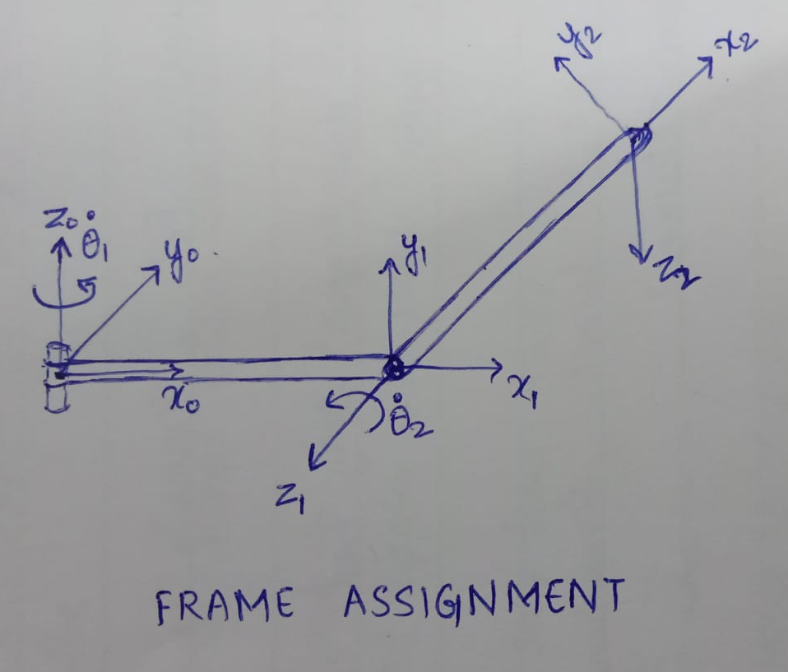
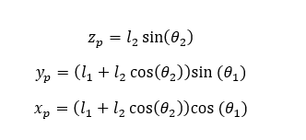
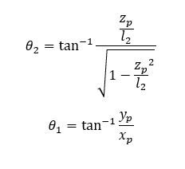
Appendix 2: D-H Parameters and Kinematic Equations
Link | a | d | α | θ
1 | l1 | 0 | 90º | θ₁
2 | l2 | 0 | 0 | θ₂
Forward Kinematic Equations
Inverse Kinematic Equations

Slide 11
Appendix 3: General Dynamic Equation
F is for frictional losses and D is for drag losses.

